Slide 1

WELCOME
COHORT 5
7th Sept – 3rd Dec 2026
Suite 6-6-7, Level 6, Menara MAA

Slide 2
Introduction to React Hooks
What are Hooks?
Functions that let you "hook into" React features
Only work in functional components
Must be called at the top level (not inside loops, conditions, or nested functions)
Notes:
- At top, not inside if, for, or any other block

Slide 3
What is State in React?
Definition: State represents data that can change over time in a component
Key Characteristics:
Local to the component
Triggers re-renders when updated
Persists between renders
Immutable updates only

Slide 4
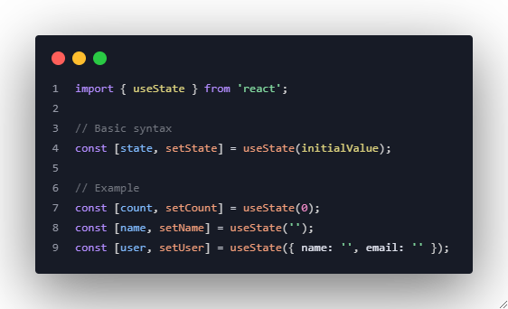
useState Hook Deep Dive

Slide 5
useState Hook Deep Dive
Key Points:
Returns an array with current state and setter function
Setter function triggers re-render
Initial value is only used on first render

Slide 6
State vs Props Comparison
State | Props
Mutable (within component) | Immutable (from component's perspective)
Local to component | Passed from parent
Can be changed by component | Cannot be changed by receiving component
Triggers re-renders when updated | Component re-renders when props change

Slide 7
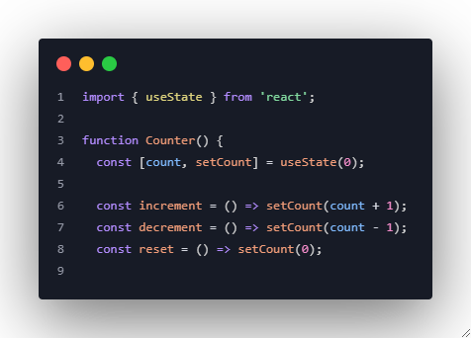
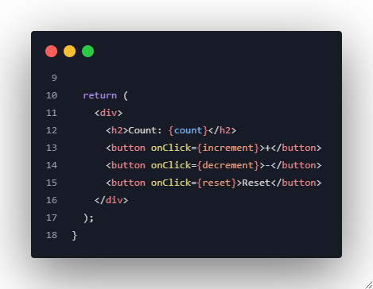
Example 1: Simple Counter

Slide 8
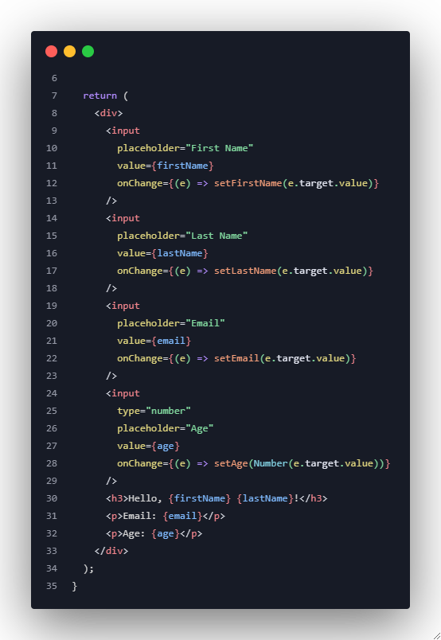
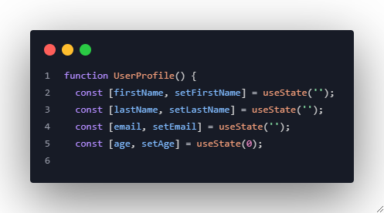
Example 2: Managing Multiple State Variables

Slide 9
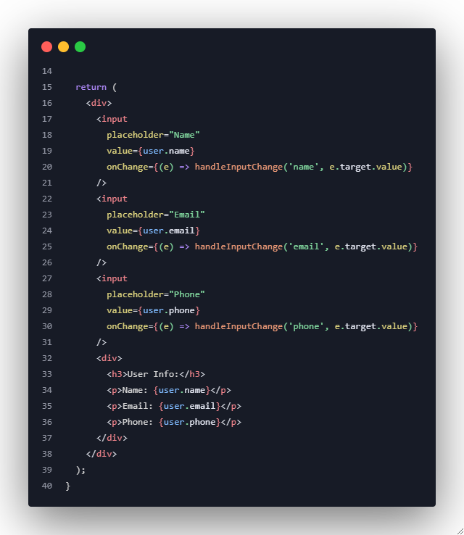
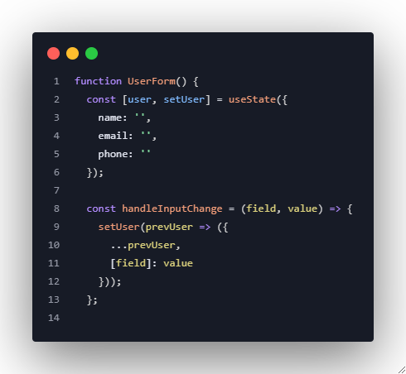
Example 3: Object State Management

Slide 10
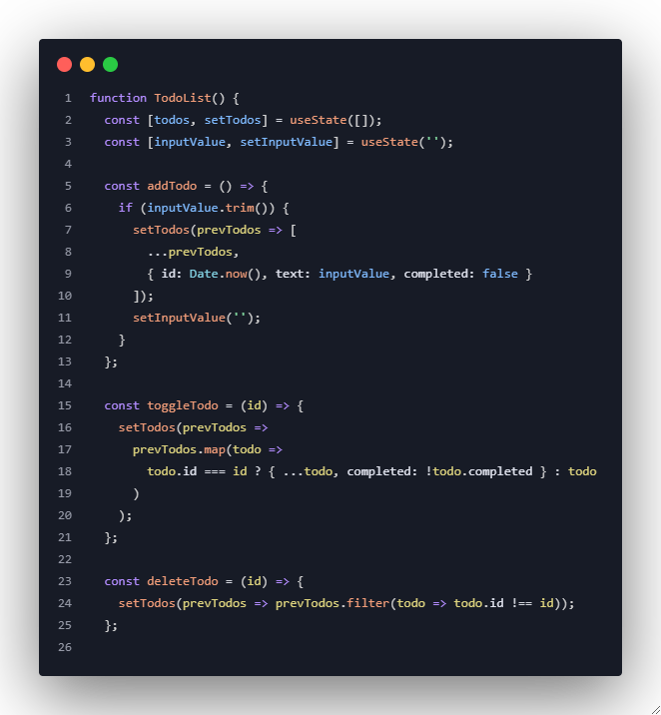
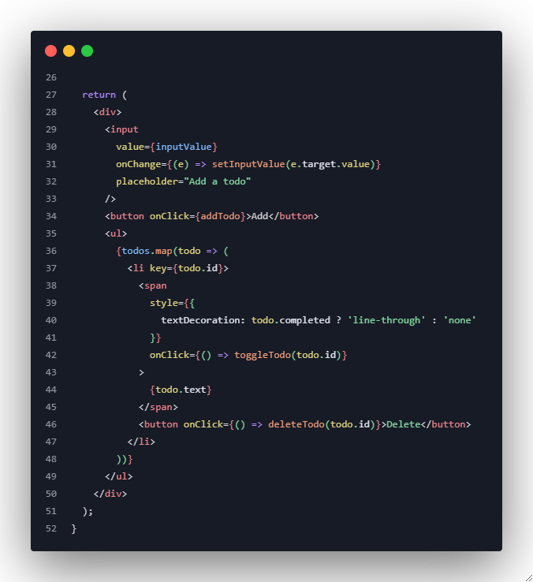
Example 4: Array State Management

Slide 11
Exercise 1: Temperature Converter
Task: Build a component that converts between Celsius and Fahrenheit
Two input fields (Celsius and Fahrenheit)
Real-time conversion as user types
Proper state management for both values

Slide 12
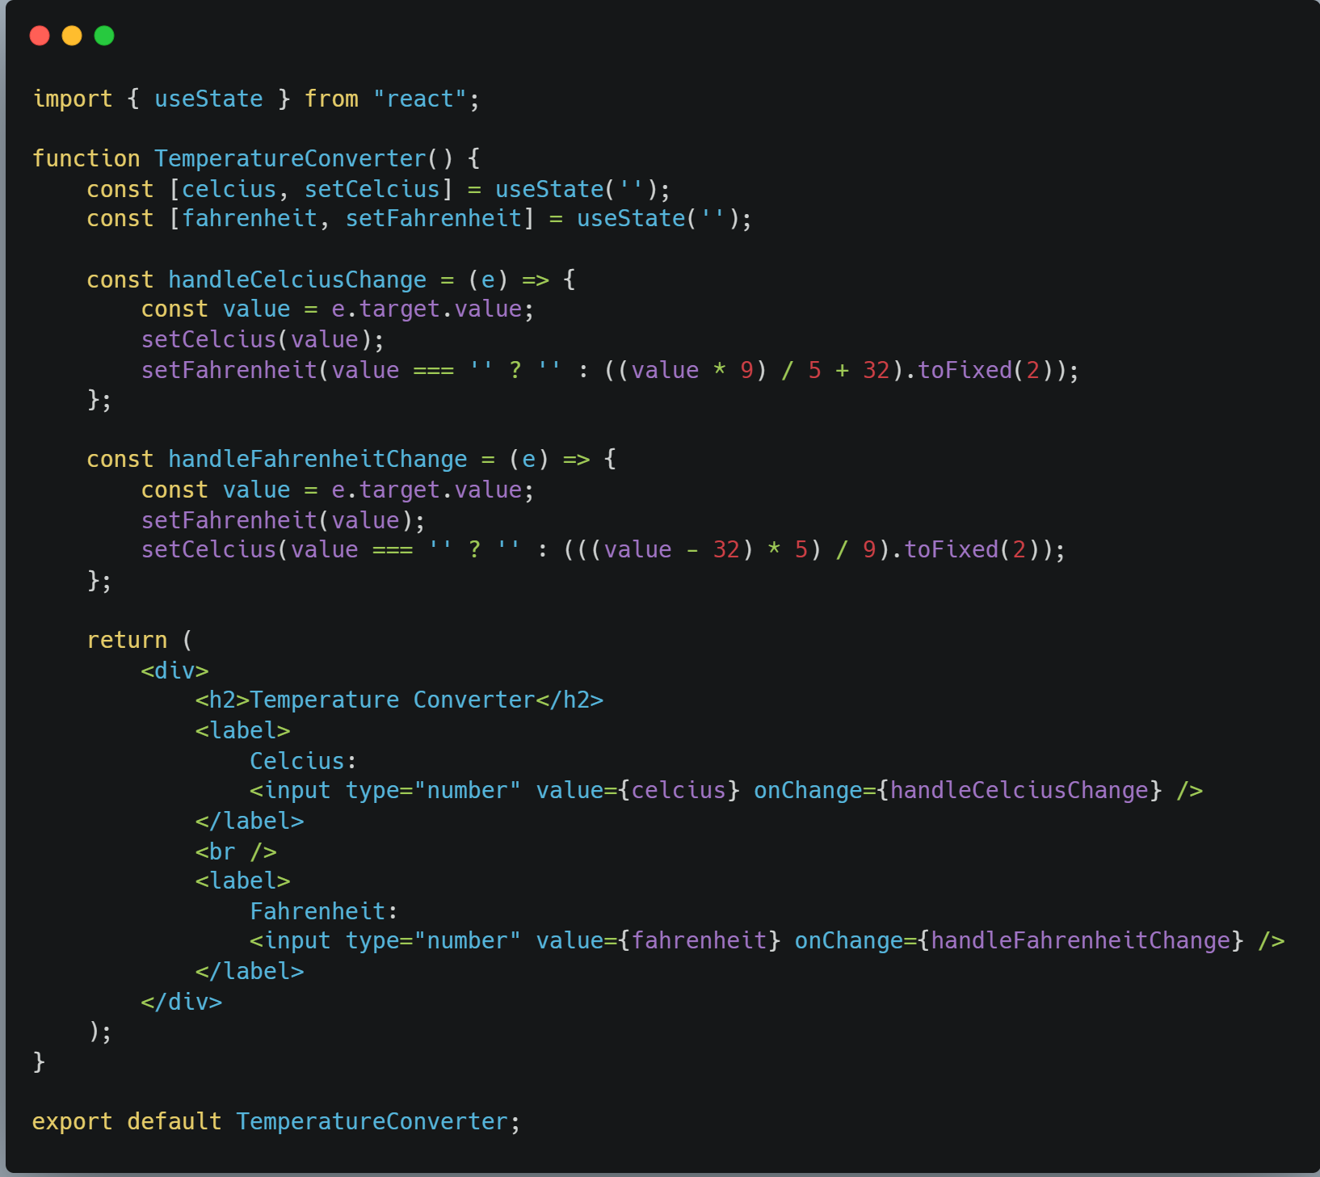
Exercise 1: Temperature Converter

Slide 13
Exercise 2: Shopping Cart
Task: Create a simple shopping cart component
Display list of products with prices
Add/remove items from cart
Show total price
Manage cart state with useState

Slide 14
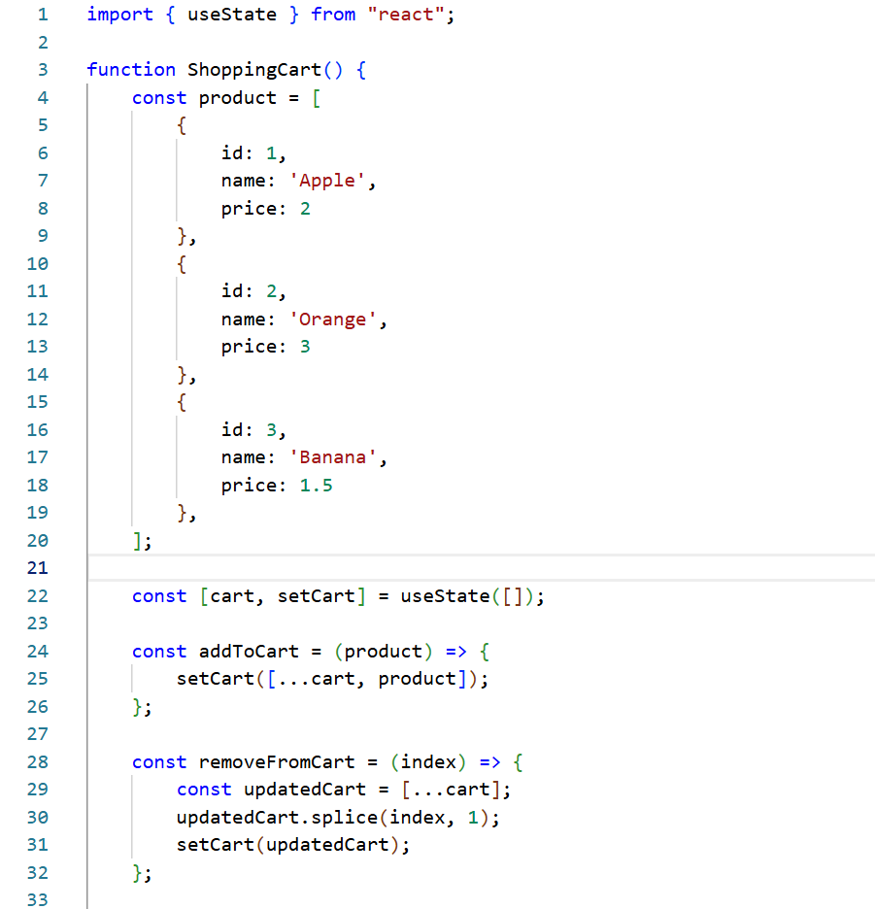
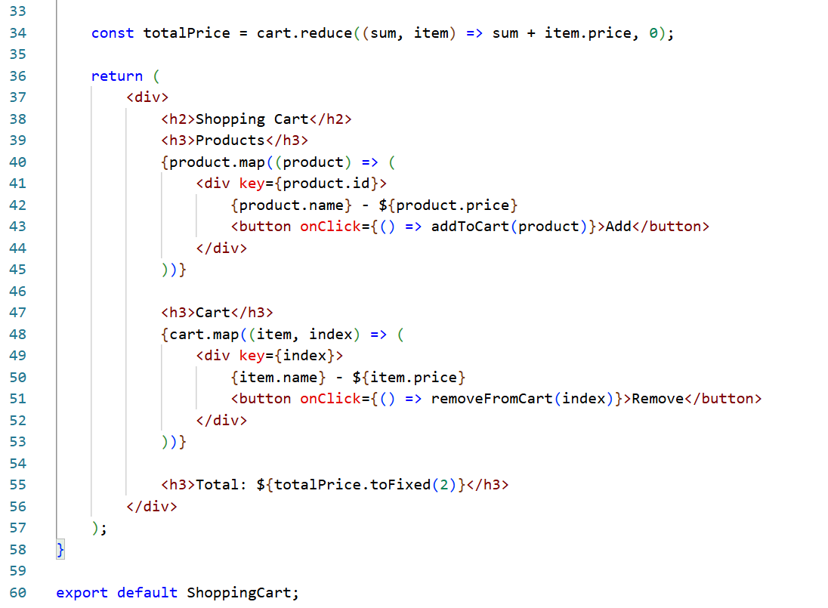
Exercise 2: Shopping Cart

Slide 15
Exercise 3: Personal Expense Tracker
Task: Build a complete expense tracking application
Add new expenses (description, amount, category)
Display list of all expenses
Calculate and show total expenses
Filter expenses by category
Delete individual expenses
(Starter Structure is in the presenter’s Notes)
Notes:
function ExpenseTracker() {
const [expenses, setExpenses] = useState([]);
const [description, setDescription] = useState('');
const [amount, setAmount] = useState('');
const [category, setCategory] = useState('food');
const [filter, setFilter] = useState('all');
// Students implement the logic
return (
<div>
{/* Form to add expenses */}
{/* Filter dropdown */}
{/* Expenses list */}
{/* Total calculation */}
</div>
);
}

Slide 16
Key Learning Outcomes
By the end of this session, students will be able to:
✅ Understand the concept of state in React
✅ Use useState hook effectively for different data types
✅ Manage complex state (objects and arrays) immutably
✅ Distinguish between state and props appropriately
✅ Handle form inputs with controlled components
✅ Apply state management best practices

